Slide 1

DeepSeek v3/R1 – How do SOTA (?) Language/Reasoning Models Work?
Maxwell Jones

Slide 2
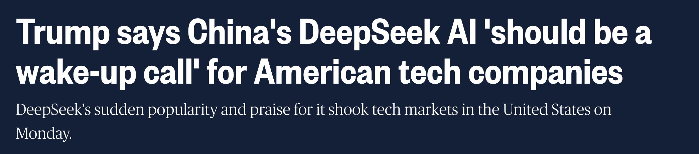
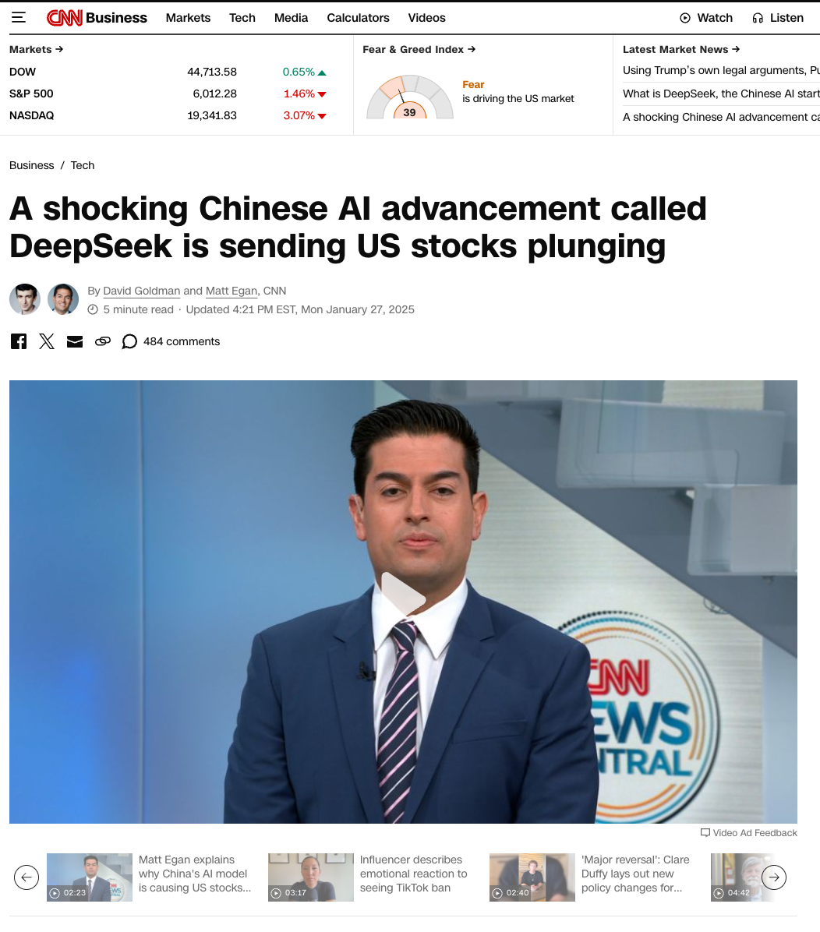
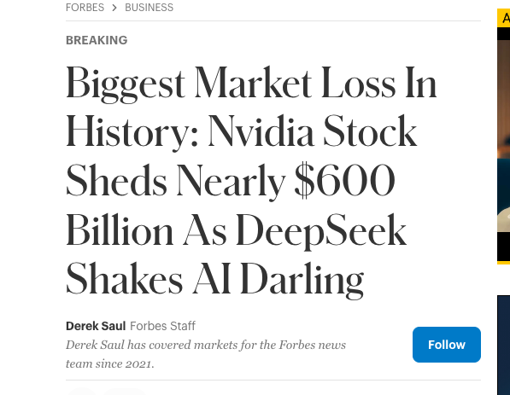
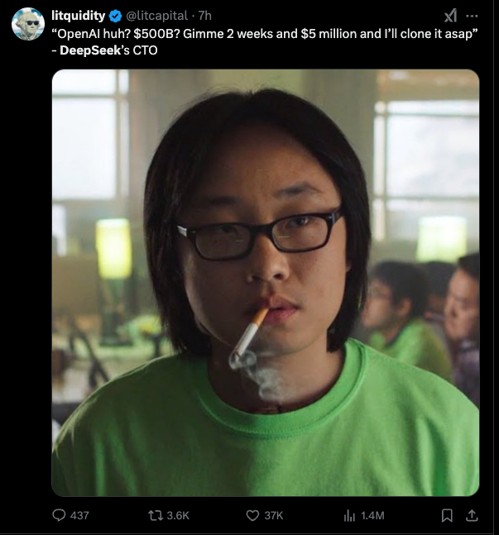
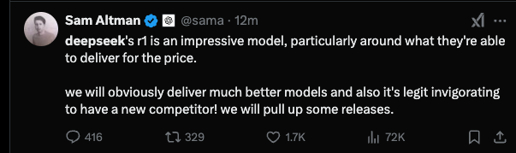
Clearly these models have hit mainstrem…
Notes:
1. Nvidia loses over 1/6th of its value (600 billion)

Slide 3
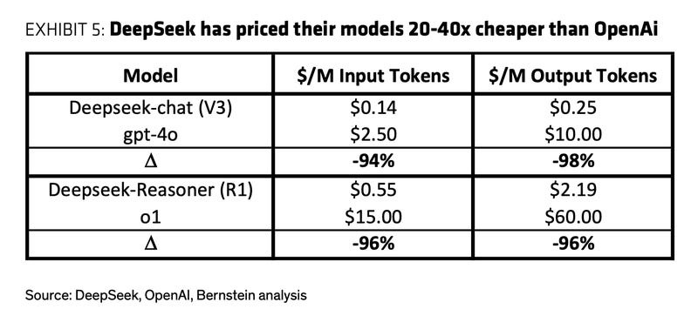
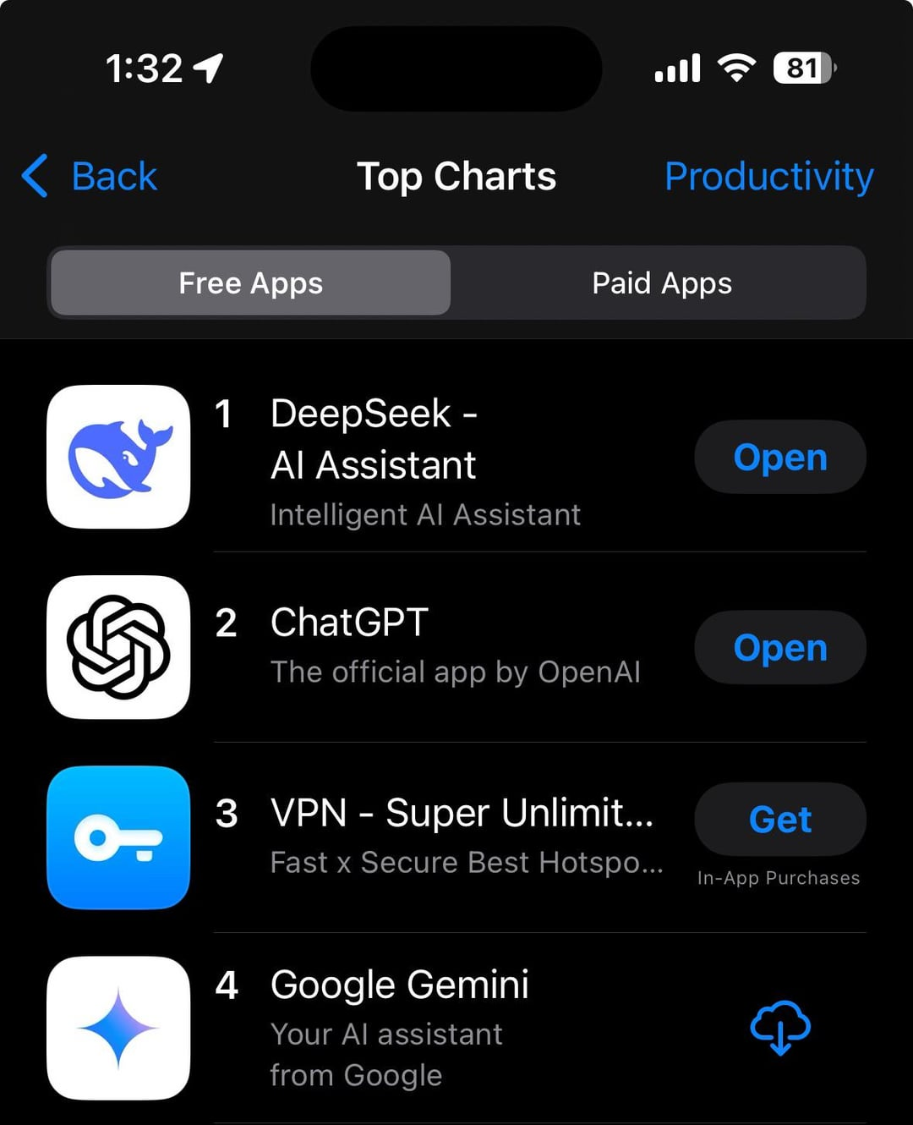
Free model weight download +local usage through ollama
Free chat feature (account creation down due to high usage…)

Slide 4
What are DeepSeek v3/DeepSeek R1
DeepSeek v3 is a very large, sparse, highly parallelized large language model that goes through:
Pretraining
Finetuning
Small Scale RL for alignment/reasoning
DeepSeek R1 is a finetuned version of DeepSeek v3 that goes through:
Large Scale RL for reasoning + some supervised fine tuning (SFT) and RLHF for alignment

Slide 5
Overview of the topics to be covered
Architecture Deep Dive (a taste)
Multi-head Latent Attention
Mixture of Experts
Multi-Token Prediction
Notes:
through the first part of the talk, I'll highlight which parts are new to the deepseek v3 paper

Slide 6
Overview of the topics to be covered
Architecture Deep Dive (a taste)
Multi-head Latent Attention
Mixture of Experts
Multi-Token Prediction
PreTraining Overview
Model size
Some dataset details
Learning rate setup etc details
Performance Details

Slide 7
Overview of the topics to be covered
Architecture Deep Dive (a taste)
Multi-head Latent Attention
Mixture of Experts
Multi-Token Prediction
PreTraining Overview
Model size
Some dataset details
Learning rate setup etc details
Performance Details
Post-Training/RL Deep Dive
How is the reasoning model (R1) trained
How is the chat model trained

Slide 8
Overview of the topics to be covered
Architecture Deep Dive (a taste)
Multi-head Latent Attention
Mixture of Experts
Multi-Token Prediction
PreTraining Overview
Model size
Some dataset details
Learning rate setup etc details
Performance Details
Post-Training/RL Deep Dive
How is the reasoning model (R1) trained
How is the chat model trained
Some of my final thoughts

Slide 9
KV Cache Overview (Autoregressive Inference)

Slide 10
Let’s look at 1 layer of 2 headed attention
KV Cache Overview (Autoregressive Inference)

Slide 11
Let’s look at 1 layer of 2 headed attention
KV Cache Overview (Autoregressive Inference)
Input Features
Token 0 (<BOS>)

Slide 12
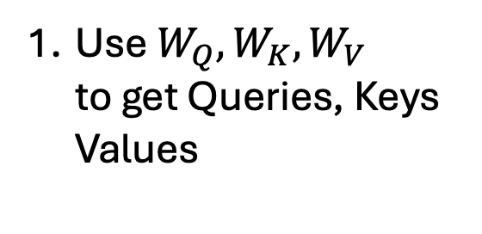
KV Cache Overview (Autoregressive Inference)
Use $W_{Q}, W_{K}, W_{V}$ to get Queries, Keys Values
Values
Keys
Queries
Input Features
Token 0 (<BOS>)

Slide 13
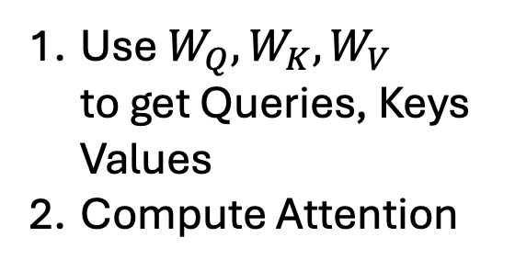
KV Cache Overview (Autoregressive Inference)
Dotted Features Boxed
Use $W_{Q}, W_{K}, W_{V}$ to get Queries, Keys Values
Compute Attention
Softmax(QK^T)V
Values
Keys
Queries
Input Features
Token 0 (<BOS>)
Token 1

Slide 14
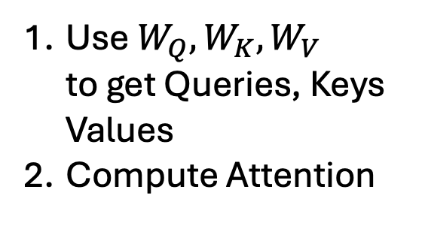
KV Cache Overview (Autoregressive Inference)
Use $W_{Q}, W_{K}, W_{V}$ to get Queries, Keys Values
Compute Attention
Softmax(QK^T)V
Note: We’re going to need our current keys and values for the next token attention cycle..
Values
Keys
Queries
Input Features
Token 0 (<BOS>)
Token 1

Slide 15

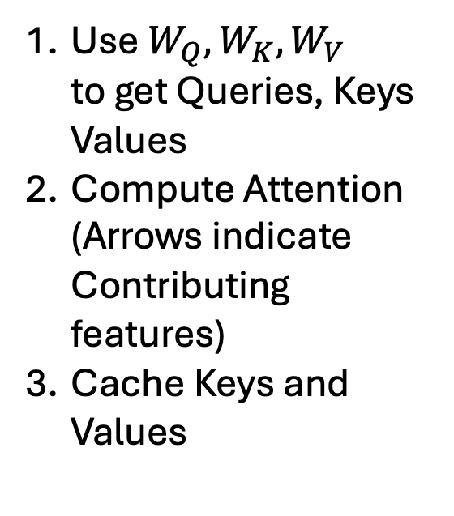
KV Cache Overview (Autoregressive Inference)
cached
Use $W_{Q}, W_{K}, W_{V}$ to get Queries, Keys Values
Compute Attention (Arrows indicate Contributing features)
Cache Keys and Values
Softmax(QK^T)V
Values
Keys
Queries
Input Features
Token 0 (<BOS>)

Slide 16
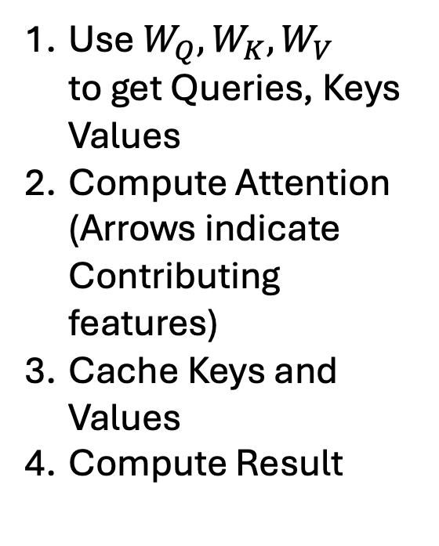
KV Cache Overview (Autoregressive Inference)
cached
Token 1
Use $W_{Q}, W_{K}, W_{V}$ to get Queries, Keys Values
Compute Attention (Arrows indicate Contributing features)
Cache Keys and Values
Compute Result
Softmax(QK^T)V
Values
Keys
Queries
Input Features
Token 0 (<BOS>)

Slide 17
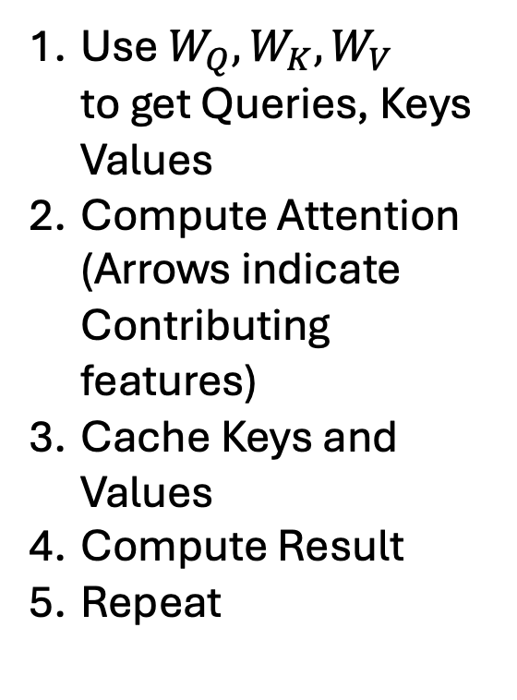
KV Cache Overview (Autoregressive Inference)
cached
Token 1
Use $W_{Q}, W_{K}, W_{V}$ to get Queries, Keys Values
Compute Attention (Arrows indicate Contributing features)
Cache Keys and Values
Compute Result
Repeat
Softmax(QK^T)V
Values
Keys
Queries
Input Features
Token 0 (<BOS>)
Token 1

Slide 18
KV Cache Overview (Autoregressive Inference)
cached
Token 1
Dotted Features Boxed
Use $W_{Q}, W_{K}, W_{V}$ to get Queries, Keys Values
Compute Attention (Arrows indicate Contributing features)
Cache Keys and Values
Compute Result
Repeat
Softmax(QK^T)V
Values
Keys
Queries
Input Features
Token 0 (<BOS>)
Token 1

Slide 19
KV Cache Overview (Autoregressive Inference)
cached
Token 1
Dotted Features Boxed
Use $W_{Q}, W_{K}, W_{V}$ to get Queries, Keys Values
Compute Attention (Arrows indicate Contributing features)
Cache Keys and Values
Compute Result
Repeat
Softmax(QK^T)V
Values
Keys
Queries
Input Features
Token 0 (<BOS>)
Token 1

Slide 20
KV Cache Overview (Autoregressive Inference)
cached
Token 1
Token 2
Dotted Features Boxed
Use $W_{Q}, W_{K}, W_{V}$ to get Queries, Keys Values
Compute Attention (Arrows indicate Contributing features)
Cache Keys and Values
Compute Result
Repeat
Softmax(QK^T)V
Values
Keys
Queries
Input Features
Token 0 (<BOS>)
Token 1

Slide 21
KV Cache Overview (Autoregressive Inference)
cached
Token 1
Token 2
Use $W_{Q}, W_{K}, W_{V}$ to get Queries, Keys Values
Compute Attention (Arrows indicate Contributing features)
Cache Keys and Values
Compute Result
Repeat
Softmax(QK^T)V
Values
Keys
Queries
Input Features
Token 0 (<BOS>)
Token 1
Token 2

Slide 22
KV Cache Overview (Autoregressive Inference)
cached
Token 1
Token 2
Use $W_{Q}, W_{K}, W_{V}$ to get Queries, Keys Values
Compute Attention (Arrows indicate Contributing features)
Cache Keys and Values
Compute Result
Repeat
Softmax(QK^T)V
Values
Keys
Queries
Input Features
Token 0 (<BOS>)
Token 1
Token 2

Slide 23
KV Cache Overview (Autoregressive Inference)
cached
Token 1
Token 2
Dotted Features Boxed
Use $W_{Q}, W_{K}, W_{V}$ to get Queries, Keys Values
Compute Attention (Arrows indicate Contributing features)
Cache Keys and Values
Compute Result
Repeat
Softmax(QK^T)V
Values
Keys
Queries
Input Features
Token 0 (<BOS>)
Token 1
Token 2

Slide 24
KV Cache Overview (Autoregressive Inference)
cached
Token 1
Token 2
Token 3
Use $W_{Q}, W_{K}, W_{V}$ to get Queries, Keys Values
Compute Attention (Arrows indicate Contributing features)
Cache Keys and Values
Compute Result
Repeat
Softmax(QK^T)V
Values
Keys
Queries
Input Features
Token 0 (<BOS>)
Token 1
Token 2

Slide 25
KV Cache Overview (Autoregressive Inference)
cached
Token 1
Token 2
Token 3
Notice: Memory storage of KV cache is Linear in size of Keys/Values – Causes constraints at inference time
Softmax(QK^T)V
Values
Keys
Queries
Input Features
Token 0 (<BOS>)
Token 1
Token 2

Slide 26
KV Cache Optimization (Autoregressive Inference)
cached
Token 1
Token 2
Token 3
Grouped Query Attention:
More Queries per key/value – found to slightly degrade performance
Softmax(QK^T)V
Values
Keys
Queries
Input Features
Token 0 (<BOS>)
Token 1
Token 2

Slide 27
KV Cache Optimization (Autoregressive Inference)
Multi-head Latent Attention (MLA):
Input Features
Token 0 (<BOS>)

Slide 28
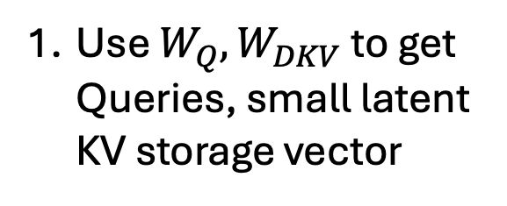
KV Cache Optimization (Autoregressive Inference)
Multi-head Latent Attention (MLA):
Use $W_{Q}, W_{DKV}$ to get Queries, small latent KV storage vector
Latent Vector
Queries
Input Features
Token 0 (<BOS>)

Slide 29
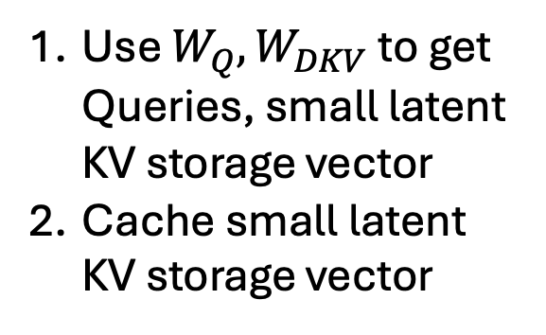
KV Cache Optimization (Autoregressive Inference)
cached
Multi-head Latent Attention (MLA):
Use $W_{Q}, W_{DKV}$ to get Queries, small latent KV storage vector
Cache small latent KV storage vector
Latent Vector
Queries
Input Features
Token 0 (<BOS>)

Slide 30
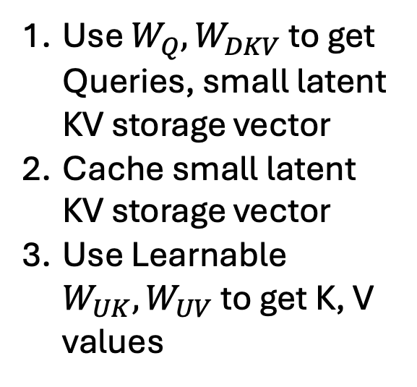
KV Cache Optimization (Autoregressive Inference)
cached
Multi-head Latent Attention (MLA):
Use $W_{Q}, W_{DKV}$ to get Queries, small latent KV storage vector
Cache small latent KV storage vector
Use Learnable $W_{UK}, W_{UV}$ to get K, V values
Values
Latent Vector
Keys
Queries
Input Features
Token 0 (<BOS>)

Slide 31
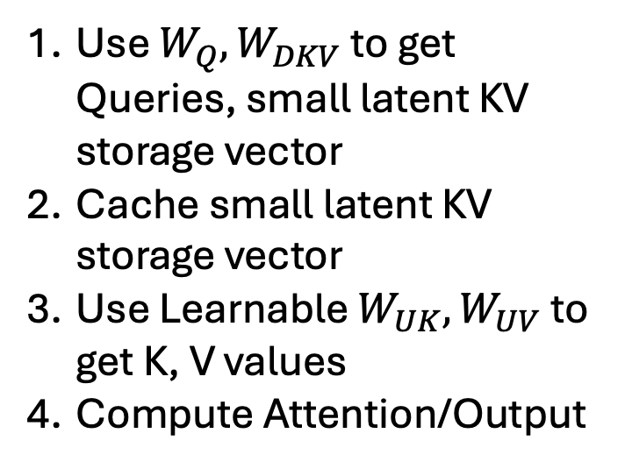
KV Cache Optimization (Autoregressive Inference)
cached
Token 1
Multi-head Latent Attention (MLA):
Softmax(QK^T)V
Use $W_{Q}, W_{DKV}$ to get Queries, small latent KV storage vector
Cache small latent KV storage vector
Use Learnable $W_{UK}, W_{UV}$ to get K, V values
Compute Attention/Output
Values
Latent Vector
Keys
Queries
Input Features
Token 0 (<BOS>)

Slide 32
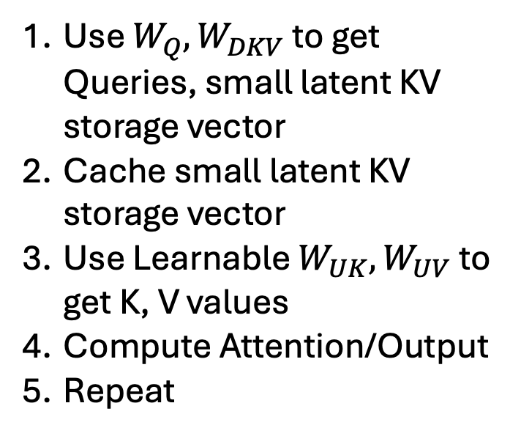
KV Cache Overview (Autoregressive Inference)
cached
Token 1
Multi-head Latent Attention (MLA):
Softmax(QK^T)V
Use $W_{Q}, W_{DKV}$ to get Queries, small latent KV storage vector
Cache small latent KV storage vector
Use Learnable $W_{UK}, W_{UV}$ to get K, V values
Compute Attention/Output
Repeat
Values
Latent Vector
Keys
Queries
Input Features
Token 0 (<BOS>)
Token 1

Slide 33
KV Cache Optimization (Autoregressive Inference)
cached
Token 1
Multi-head Latent Attention (MLA):
Softmax(QK^T)V
Use $W_{Q}, W_{DKV}$ to get Queries, small latent KV storage vector
Cache small latent KV storage vector
Use Learnable $W_{UK}, W_{UV}$ to get K, V values
Compute Attention/Output
Repeat
Values
Latent Vector
Keys
Queries
Input Features
Token 0 (<BOS>)
Token 1

Slide 34
KV Cache Optimization (Autoregressive Inference)
cached
Token 1
Multi-head Latent Attention (MLA):
Softmax(QK^T)V
Use $W_{Q}, W_{DKV}$ to get Queries, small latent KV storage vector
Cache small latent KV storage vector
Use Learnable $W_{UK}, W_{UV}$ to get K, V values
Compute Attention/Output
Repeat
Values
Latent Vector
Keys
Queries
Input Features
Token 0 (<BOS>)
Token 1

Slide 35
KV Cache Optimization (Autoregressive Inference)
cached
Token 1
Multi-head Latent Attention (MLA):
Softmax(QK^T)V
Use $W_{Q}, W_{DKV}$ to get Queries, small latent KV storage vector
Cache small latent KV storage vector
Use Learnable $W_{UK}, W_{UV}$ to get K, V values
Compute Attention/Output
Repeat
Values
Latent Vector
Keys
Queries
Input Features
Token 0 (<BOS>)
Token 1

Slide 36
KV Cache Optimization (Autoregressive Inference)
cached
Token 1
Token 2
Multi-head Latent Attention (MLA):
Softmax(QK^T)V
Use $W_{Q}, W_{DKV}$ to get Queries, small latent KV storage vector
Cache small latent KV storage vector
Use Learnable $W_{UK}, W_{UV}$ to get K, V values
Compute Attention/Output
Repeat
Values
Latent Vector
Keys
Queries
Input Features
Token 0 (<BOS>)
Token 1

Slide 37
KV Cache Optimization (Autoregressive Inference)
cached
Token 1
Token 2
Note: Up projecting and doing attention in the large Q, K space is costly…
Softmax(QK^T)V
Values
Latent Vector
Keys
Queries
Input Features
Token 0 (<BOS>)
Token 1

Slide 38
KV Cache Optimization (Autoregressive Inference)
cached
Token 1
Token 2
Note: Up projecting and doing attention in the large Q, K space is costly…
Softmax(QK^T)V
Values
Latent Vector
It is equivalent to down projecting queries, and doing attention with latent vector! (cheaper)
Keys
Queries
Input Features
Token 0 (<BOS>)
Token 1

Slide 39
KV Cache Optimization (Autoregressive Inference)
cached
Token 1
Token 2
Note: Up projecting and doing attention in the large Q, K space is costly…
Softmax(QK^T)V
Values
Latent Vector
It is equivalent to down projecting queries, and doing attention with latent vector! (cheaper)
Keys
Queries
Input Features
Token 0 (<BOS>)
Token 1

Slide 40
KV Cache Optimization (Autoregressive Inference)
cached
Token 1
Token 2
Note: Up projecting and doing attention in the large Q, K space is costly…
Softmax(QK^T)V
Values
It is equivalent to down projecting queries, and doing attention with latent vector! (cheaper)
Latent Vector
Keys
Queries
Takeaway: For the same compute, it’s better to have more, smaller attention than less, larger attention
Input Features
Token 0 (<BOS>)
Token 1

Slide 41
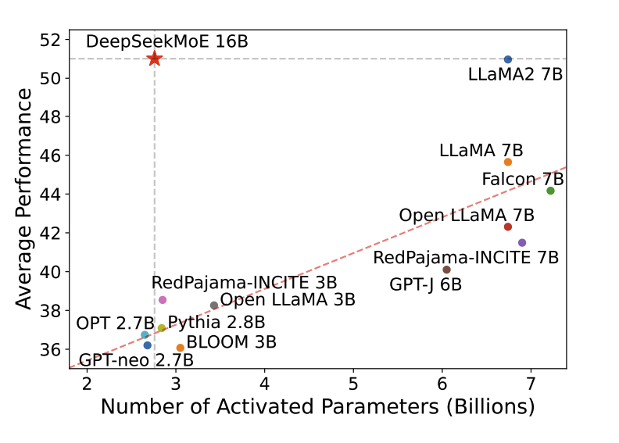
Mixture of Experts Overview

Slide 42
Mixture of Experts Overview
Replace the Feed Forward Network (FFN) after Transformer block with MoE
Sparsity technique to deliver strong performing models with:
Scalable parameters (scaling law says more parameters + more data better) while keeping computation costs per token low (sparsity, parallelism)
Ideally, all experts are used uniformly (good load balancing/usage of larger weight space)
Many FFN, only a few activated per token
FFN
(Feed Forward Network)
Transformer Block
Transformer Block
Basic Transformer
Input Features
MoE Transformer
Input Features
Notes:
We want to have a large number of experts, all of which are used uniformly and sparsly

Slide 43
How does MoE work?
Expert 1
Expert 2
Expert 3
Expert 4
Expert 5
Learnable Expert 1 Centroid Features
Learnable Expert 2 Centroid Features
Learnable Expert 3 Centroid Features
Learnable Expert 4 Centroid Features
Learnable Expert 5 Centroid Features
Input Features
Notes:
all randomly intialized NNs with no prior info
learnable routing features randomly initialized

Slide 44
How does MoE work?
Expert 1
Expert 2
Expert 3
Expert 4
Expert 5
.1
.5
.3
.8
.6
Learnable Expert 1 Centroid Features
Learnable Expert 2 Centroid Features
Learnable Expert 3 Centroid Features
Learnable Expert 4 Centroid Features
Learnable Expert 5 Centroid Features
Compute Dot Product Similarity, smooth with sigmoid
Input Features

Slide 45
How does MoE work?
.8
.6
Expert 1
Expert 2
Expert 3
Expert 4
Expert 5
Execute top k experts
Input Features

Slide 46

How does MoE work?
.8
.6
Expert 1
Expert 2
Expert 3
Expert 4
Expert 5
Weighted sum of the result
Input Features

Slide 47
How does MoE work?
.8
.6
Expert 1
Expert 2
Expert 3
Expert 4
Expert 5
NOTE: You backprop through the activated experts, as well as through the learnable centroids used for routing
Input Features
Notes:
there are also methods to try to stop routing collapse

Slide 48
DeepSeeks MoE improvements
More, Smaller Experts (helps with expert specialization)
.8
.9
.7
Expert 1
Expert 2
Expert 3
Expert 4
Expert 5
Expert 6
Expert 7
.8
.2
.4
.9
.7
.3
.6
Input Features

Slide 49
DeepSeeks MoE improvements
Shared Expert
Routed Expert
More, smaller experts (helps with expert specialization)
Some experts always get activated (reduces shared knowledge/redundancy)
1
1
.9
.7
Expert 1
Expert 2
Expert 3
Expert 4
Expert 5
Expert 6
Expert 7
.4
.9
.7
.3
.6
Input Features
Notes:
MoE is known to have issues with routing collapse - say we are overusing expert 4

Slide 50
DeepSeeks MoE improvements
Shared Expert
Routed Expert
More, smaller experts (helps with expert specialization)
Some experts always get activated (reduces shared knowledge/redundancy)
New Load Balancing Formulation
If an expert is being overused, downweight its centroid/feature dot product (new, only for routing, not summation, helps with load balancing)
1
1
.7
.6
Expert 1
Expert 2
Expert 3
Expert 4
Expert 5
Expert 6
Expert 7
.4
.9 -> .5
.7
.3
.6
Input Features
Input Features

Slide 51
DeepSeeks MoE improvements
Shared Expert
Routed Expert
More, smaller experts (helps with expert specialization)
Some experts always get activated (reduces shared knowledge/redundancy)
New Load Balancing Formulation
If an expert is being overused, downweight its centroid/feature dot product (new!)
Enforce requirements on # of GPU nodes activated per token
1
1
.7
.6
Expert 1
Expert 2
Expert 3
Expert 4
Expert 5
Expert 6
Expert 7
.4
.9 -> .5
.7
.3
.6
Node 1
Node 2
Input Features
Input Features
Notes:
8 experts per token, 1 shared expert, at most 4 nodes per token,

Slide 52
GPU/Hardware Considerations
They also deploy redundant high load expert copies for less token drop/more efficiency (new!)
Deepseek spends 10 pages on:
Communications infrastructure between nodes
Fancy forward and backward pass of the model across nodes
Fancy mixed precision training (new!)
Fp8, BF16, FP32,
But we’ll skip these completely…

Slide 53
Multi-Token Prediction
Output Token
Main Model, Does Attention on all previous tokens
Input Tokens

Slide 54
Multi-Token Prediction
Output Token
Next Token
Features
Main Model, Does Attention on all previous tokens
Second Token Prediction Model, gets previous features + previous token, lots of shared weights
New: Sequential, as opposed to prior work which was parallel
Input Tokens
Output Token
Notes:
2 tokens generated at a time at inference time
I’m skipping the Various floating point/communications/mixed precision level optimizations, but there are a lot of these some of which I don’t understand fully so feel free to check out the paper for more details

Slide 55
My Takeaways on Architecture
For every part of the architecture, the methods presented show high level of detail/thought out innovation to improve over previous methods.
Attention mechanism
MoE design
Throughput/communication across nodes (new-ish)
Mixed precision training (new)
Notes:
my opinion is: for ever part of the architecture/training setup (attention, MoE, precision, communication), significant work has been done to try and optimize performance

Slide 56
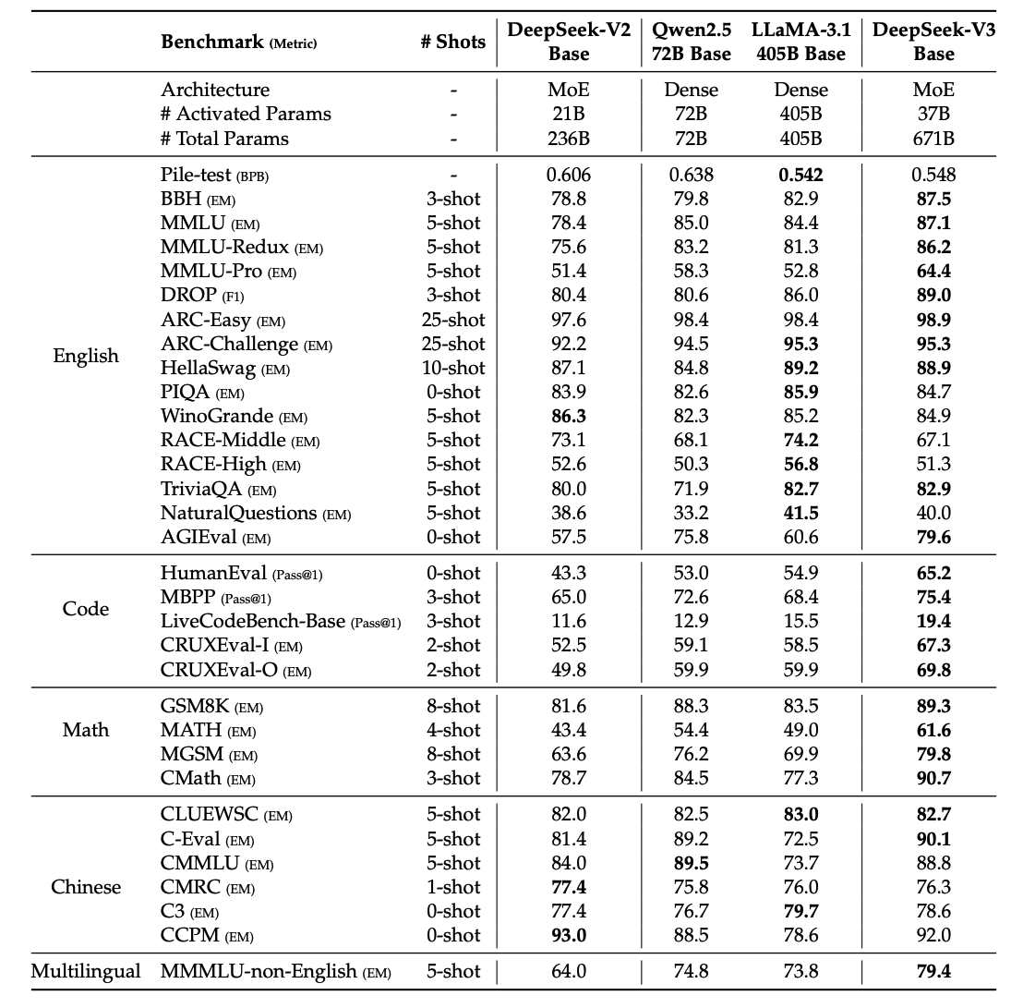
Pretraining Details
No Dataset details other than # of tokens (14.8 Trillion Tokens)

Slide 57
Pretraining Details
No Dataset details other than # of tokens (14.8 Trillion Tokens)
671B params, 37B active per token

Slide 58
Pretraining Details
No Dataset details other than # of tokens (14.8 Trillion Tokens)
671B params, 37B active per token
Fill-in-middle autoregressive training 10% of the time: <start>start_tokens<\start> <end>end_tokens<\end> <mid>mid_tokens<\mid>

Slide 59
Pretraining Details
No Dataset details other than # of tokens (14.8 Trillion Tokens)
671B params, 37B active per token
Fill-in-middle autoregressive training
AdamW Optimizer, linear lr warmup, followed by constant, cosine decay, then constant again with one last drop to the lowest constant level

Slide 60
Pretraining Details
No Dataset details other than # of tokens (14.8 Trillion Tokens)
671B params, 37B active per token
Fill-in-middle autoregressive training (present start and end before middle 10% of time)
AdamW Optimizer
2.788M H800 GPU Hours, ~ $5M dollars of pure training cost (2048 GPUs, 8 GPUs per node, 256 nodes)
30.8 M H100 80 Gb GPU Hours for Llama 3.1 405B (16K H100s over 54 days) though it’s probably a good amount less
Notes:
2048 NVIDIA h800 GPUs, 8 GPUs per node, 256 nodes

Slide 61
Pretraining Details
No Dataset details other than # of tokens (14.8 Trillion Tokens)
Fill-in-middle autoregressive training (present start and end before middle 10% of time)
AdamW Optimizer, linear lr warmup, followed by constant, cosine decay, then constant again with one last drop to the lowest constant level
2.788M H800 GPU Hours, ~ $5M dollars of pure training cost
Context Length 128K (same as GPT4-Turbo)

Slide 62
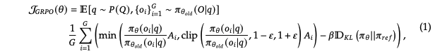
DeepSeek R1-Zero – Initial Training
Group Relative Policy Optimization (for a group of trajectories)
Similar to PPO (clipped policy improvement objective, advantage function)
Similar to TRPO: Add KL divergence penalty

Slide 63
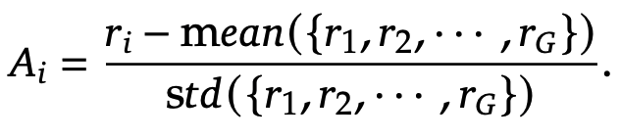
DeepSeek R1-Zero – Initial Training
Group Relative Policy Optimization (for a group of trajectories)
Similar to PPO (clipped policy improvement objective, advantage function)
Similar to TRPO: Add KL divergence penalty
Similar to REINFORCE (no value model, bootstrap value from current reward – (average reward of group))
Reward is just: ”did you get it right” and “did you format as <think>…<\think><answer>…<\answer>”

Slide 64
DeepSeek R1-Zero – Initial Training
Group Relative Policy Optimization (for a group of trajectories)
Similar to PPO (clipped policy improvement objective)
Add KL divergence penalty
Similar to REINFORCE (no value model, bootstrap value from current reward – (average reward of group))
Reward is just: ”did you get it right” and “did you format as <think>…<\think><answer>…<\answer>”
Trained for ”Thousands of RL steps”

Slide 65
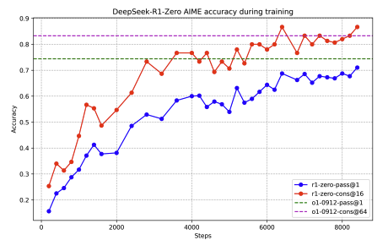
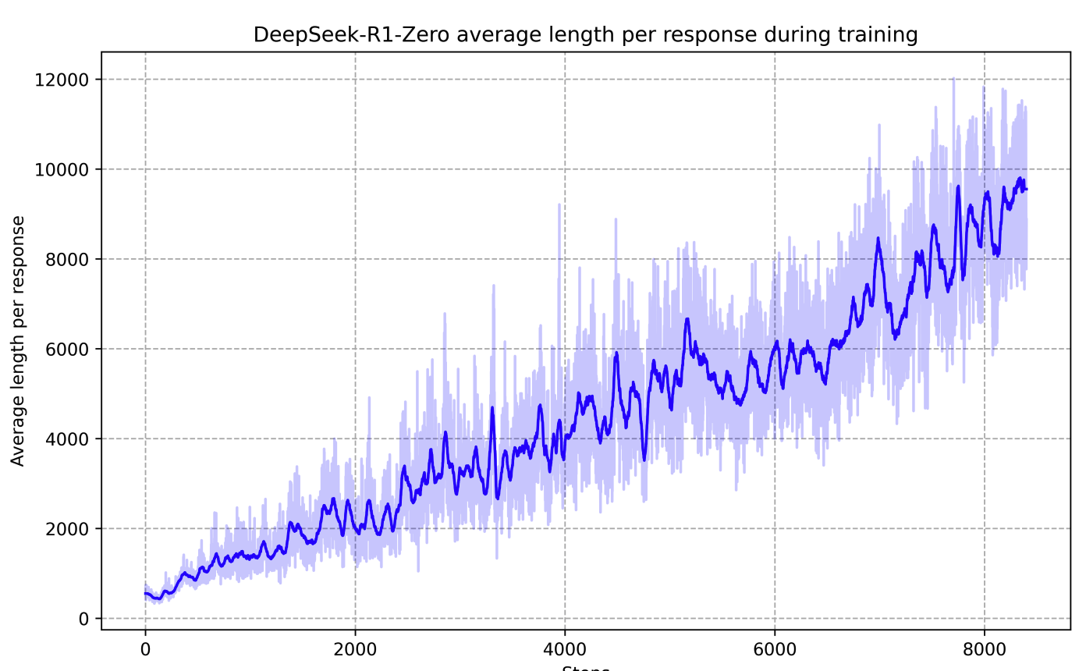
DeepSeek R1-Zero – General Vibe
Designing a value function adds memory overhead/complicates things
Trying to design a neural reward function/step by step reward can lead to reward hacking - tricky to do in general
Tree Searching is hard over exponential token space – just let the model learn how to get rewards for data with ground truth answers!
”yapping machine”

Slide 66
DeepSeek R1 Setup
Want to prevent rambling, language switching, etc from R1-Zero
First, supervised finetune with some carefully curated reasoning data (“thousands of cold start data”)
Notes:
Cold start data is good data from R1 as well as chain of thought prompting the base model etc
Non reasoning data includes stuff like creative writing, etc
Rejection sampling includes stuff like: removing language switch, too much rambling, using the model to pick which responses it thinks are best for non reasoning, etc

Slide 67
DeepSeek R1 Setup
"By carefully designing the pattern for cold-start data with human priors, we observe better performance against DeepSeek-R1-Zero. We believe the iterative training is a better way for reasoning models.“

Slide 68
DeepSeek R1 Setup
Want to prevent rambling, language switching, etc from R1-Zero
First, supervised finetune with some carefully curated reasoning data (“thousands of cold start data”)
Next, Large Scale RL as before
Add language consistency reward to discourage language mixing, only slight performance degradation
Notes:
Cold start data is good data from R1 as well as chain of thought prompting the base model etc
Non reasoning data includes stuff like creative writing, etc
Rejection sampling includes stuff like: removing language switch, too much rambling, using the model to pick which responses it thinks are best for non reasoning, etc

Slide 69
DeepSeek R1 Setup
Want to prevent rambling, language switching, etc from R1-Zero
First, supervised finetune with some carefully curated reasoning data (“thousands of cold start data”)
Next, Large Scale RL as before
Add language consistency reward to discourage language mixing, only slight performance degradation
Once RL converged, collect more data (both reasoning and non reasoning) from new model with rejection sampling
Good reasoning trajectories (no rambling, language mixing)
Good non reasoning trajectories (writing, QA, self-cognition, etc) from DeepSeekv3, adding a chain of thought via prompting
Notes:
Cold start data is good data from R1 as well as chain of thought prompting the base model etc
Non reasoning data includes stuff like creative writing, etc
Rejection sampling includes stuff like: removing language switch, too much rambling, using the model to pick which responses it thinks are best for non reasoning, etc

Slide 70
DeepSeek R1 Setup
Want to prevent rambling, language switching, etc from R1-Zero
First, supervised finetune with some carefully curated reasoning data (“thousands of cold start data”)
Next, Large Scale RL as before
Add language consistency reward to discourage language mixing, only slight performance degradation
Once RL converged, collect more data (both reasoning and non reasoning) from new model with rejection sampling
Do SFT on final dataset (600K reasoning, 200K non reasoning)
Notes:
Cold start data is good data from R1 as well as chain of thought prompting the base model etc
Non reasoning data includes stuff like creative writing, etc
Rejection sampling includes stuff like: removing language switch, too much rambling, using the model to pick which responses it thinks are best for non reasoning, etc

Slide 71
DeepSeek R1 Setup
Want to prevent rambling, language switching, etc from R1-Zero
First, supervised finetune with some carefully curated reasoning data (“thousands of cold start data”)
Next, Large Scale RL as before
Add language consistency reward to discourage language mixing, only slight performance degradation
Once RL converged, collect more data (both reasoning and non reasoning) from new model with rejection sampling
Do SFT on collected dataset (600K reasoning, 200K non reasoning)
Final RL stage including:
More GRPO on fixed reward data
[RLHF] for helpfulness/harmlessness
Notes:
Cold start data is good data from R1 as well as chain of thought prompting the base model etc
Non reasoning data includes stuff like creative writing, etc
Rejection sampling includes stuff like: removing language switch, too much rambling, using the model to pick which responses it thinks are best for non reasoning, etc

Slide 72
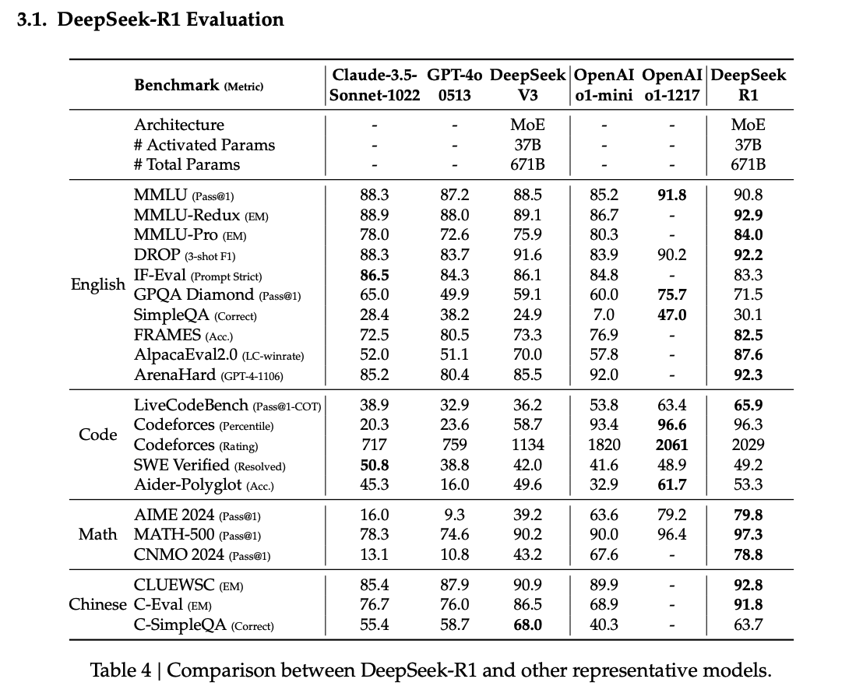
DeepSeek R1 Results
Good Results on AIME, Codeforces
Also good results on SWE Verified
Fix PR requests, and pass hidden unit tests (people care about this benchmark for replacing SWEs I think)
Most people agree it is clearly better than GPT-o1 mini and GPT-4o for reasoning
Debate about its performance compared to o1
Notes:
Cold start data is good data from R1 as well as chain of thought prompting the base model etc
Rejection sampling includes stuff like: removing language switch, too much rambling, using the model to pick which responses it thinks are best for non reasoning, etc

Slide 73

Fun DeepSeek R1 Math Example from Me
I asked DeepSeek R1(distilled) to find the value of this summation (the value is 1)
Here are some funny moments from it’s (correct) solution:

Slide 74
Fun DeepSeek Math Example from Me
The inner sum is ∑_{i=k}^N {i - 1 choose k - 1}. Hmm, this looks familiar. Isn't there an identity for the sum of binomial coefficients? Let me recall... Yes! There's a hockey-stick identity or perhaps another combinatorial identity that allows such summation.
Wait, actually, I think it might be related to the cumulative sum of combinations with fixed lower index. Specifically, ∑_{r=0}^{n} {r choose k} = {n+1 choose k+1}. But in our case, the terms are from i=k to N, so if we set m = i - 1, when i=k, m=k-1, and when i=N, m=N-1. So the sum becomes ∑_{m=k-1}^{N-1} {m choose k-1}. Ah, that's better because it aligns with the identity I was thinking of

Slide 75
Fun DeepSeek Math Example from Me
….. But wait, hold on. Let me go back step by step to make sure I didn't skip any steps.
….. Wait, that's surprising! The entire expression simplifies to 1. But let me verify step by step because this seems too straightforward. Maybe I missed a step somewhere.
….. Wait, so that's it! The entire expression simplifies down to 1. So is this correct? It seems too simple, but let me think about the logic.
….. Wait, let me try plugging in small numbers for N and k to see if it holds. Let's pick N=2, k=1.
… Hence seems consistent that the sum is always 1. So despite my initial surprise, after testing small cases and going through the algebra step by step, the expression does indeed simplify to 1.

Slide 76
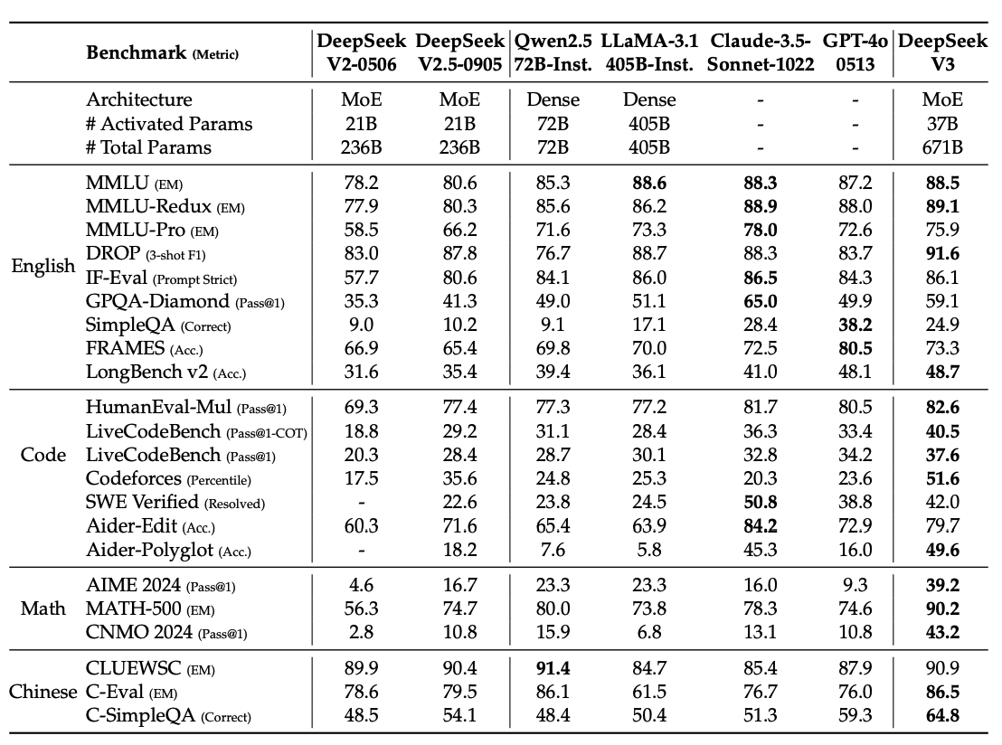
DeepSeek v3 PostTraining
SFT with:
R1 Trajectories
DeepSeek 2.5 Chat Trajectories
RL with:
In house reward model
Creative writing reward model trained on deepseekv3 LLM as judge
Format reward model for math/coding

Slide 77
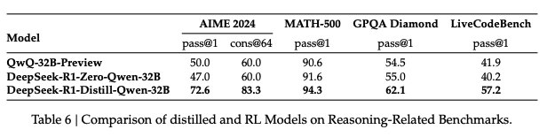
Distillation/Self Rewarding as tools for Learning
DeepSeek Researchers found that distilling R1 Reasoning chains into smaller models like Qwen outperformed RL on Qwen itself
Further, they found that creating a reward by prompting the model on its own creative writing outputs was also a promising technique

Slide 78
Unknowns
What data was used to train these models?
How much was bootstrapped from Claude, GPT, etc?
How cleaned/prepared was the data?
How many GPUs does DeepSeek actually have for research & development?
Unclear, wild speculation on final number and about hidden GPUs
How does this affect the pricing models of american companies?
No one is going to pay $200 for a model that’s only 1% better than a free/downloadable reasoning model from deepseek – thus market freakout
How long can deepseek host lots of traffic to its large chat and reasoning models (Sam Altman says o1 loses money)?

